Slide 1
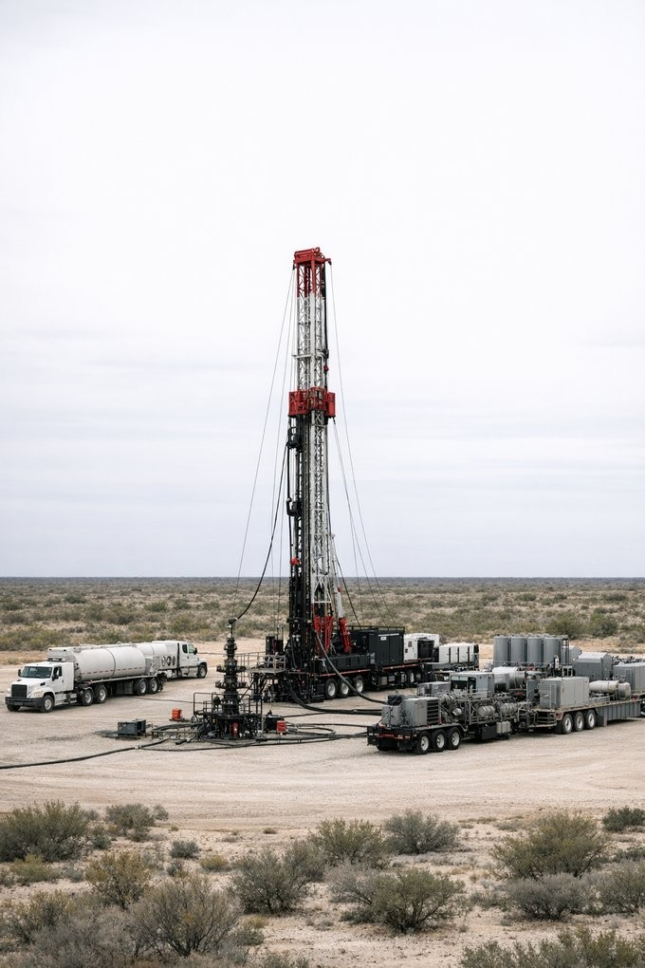
Trapped Reserves. Produced.
Activating Proved Reserves Through ORRI Conveyance
SIPES Midland Chapter | April 22, 2026 Dan Mooney, CPA, CFA
Enstream Capital Management
You keep the wells. You keep the company.

Slide 2
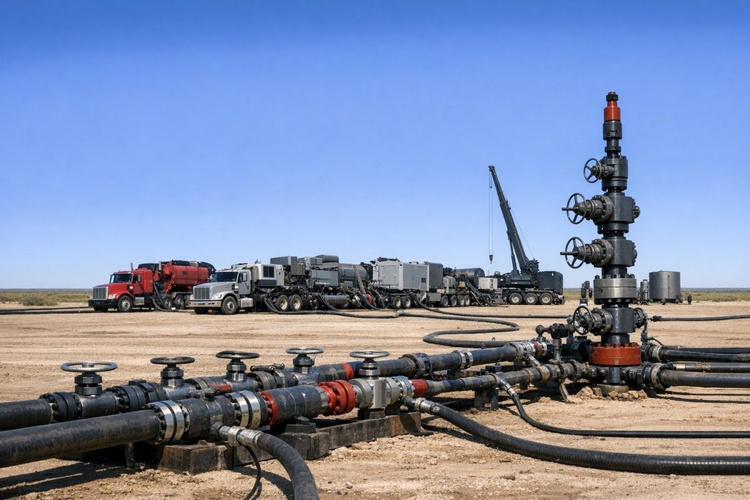


Proved Reserves. Trapped Capital.
Bank Debt
Requires cash flow the wells don't have yet
Equity
Dilutes ownership and control
Mezzanine
Expensive, restrictive, slow to close
Millions
of proved barrels sit idle across mature U.S. basins
Not because the geology is uncertain
— because the nancing doesn't t.

Slide 3


Enstream Capital Management
2006
Founded
$1B+
Advised
2022
Pivoted
Energy investment banking firm in Dallas
Capital transactions serving O&G operators
Direct ORRI purchases in proved wellbores
We buy ORRIs so operators can produce proved reserves — no debt, no equity, no change of control.

Slide 4
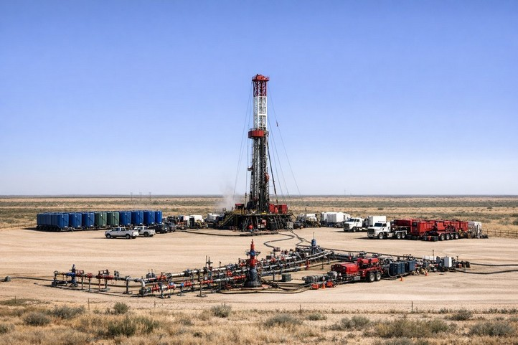

Three Types Of Trapped Reserves
Shut-in wells
Behind-pipe zones
Recompletions
Proved reserves ready to flow, waiting on capital
Proved zones behind casing never perforated
Wells needing mechanical work plus bypassed zones
No new drilling risk — just turn-on or minor surface work
Completion-ready with engineering support
Oken the highest-return category — infrastructure exists
In every case: the geology is proved, the wellbore is drilled, the infrastructure is in place — the missing piece is capital.

Slide 5

How It Works: The Flow
A perpetual overriding royalty interest — a real property conveyance, not a loan, not a security.
Operator conveys ORRI
Enstream purchases ORRI
Proceeds escrowed
Operator executes plan
Production flows
ORRI steps down at payout
→
→
→
→
→

Slide 6

Key Terms
75/25 split
Enstream (ORRI) covers up to 75% of capex; operator (WI) co-invests 25%
Escrowed proceeds
ORRI purchased at closing; proceeds fund development plan
200%+ payout target
200%+ ORRI payout target, then step-down to small % of NRI in perpetuity
Reconveyance option
Operator can reconvey and eliminate royalty after payout
Bank-friendly
Standard industry documentation; no encumbrance on credit facility

Slide 7




Wellbores: Where The Capital Flows
Operator (WI)
Co-invests 25% of capex
Enstream (ORRI)
Purchases ORRI (75% of capex)
↓
↓
Escrowed Proceeds
Drawn against approved development milestones
↓
Development & Production
Operator executes plan | Reserves convert to production
↓
Operator Revenue
NRI less ORRI burden Growing share as ORRI steps down
Enstream Revenue
25%-75% NRI until 200%+ payout Then reduces to tail royalty

Slide 8

Why Operators Choose This Structure
Operator Outcomes
No debt on balance sheet
You keep the wells.
You keep the company.
No equity dilution
Retain full operational control
Strengthens collateral value
Converts PDNP to PDP
Streamlined closing process | Standard industry documentation

Slide 9



Reserve Report To First Production
Streamlined process from LOI to closing
1 2
3
4
5
6
* →
→
→
→
Submit reserve report
Execute LOI
Plan approval
Documentation
Close & escrow
Execute plan
Diligence includes:
Reserve report review
Engineering validation
Title & environmental screening
Operator track record
"We'll tell you within two weeks if we can close."
Designed not to waste an operator's time. If the fit isn't there, we say so early.

Slide 10
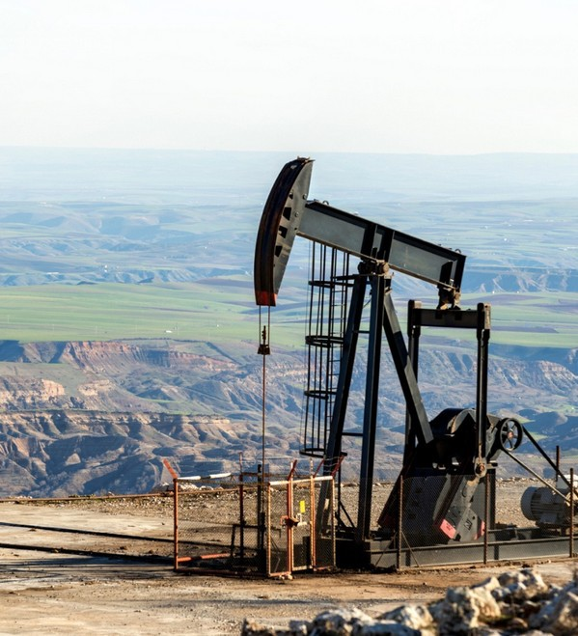
Big Horn Basin, Wyoming
$6.9MM – 31-well PDNP activation and workover plan
Key metrics
$5.2MM
ORRI purchase price (75% of Capex)
$1.7MM
Operator capital (25% of Capex)
200%
Payout target
ORRI structure
50-75% of NRI
Before Payout
5-15% of NRI
Aker Payout
ORRI Reconveyance Option
2 – 4 Years

Slide 11
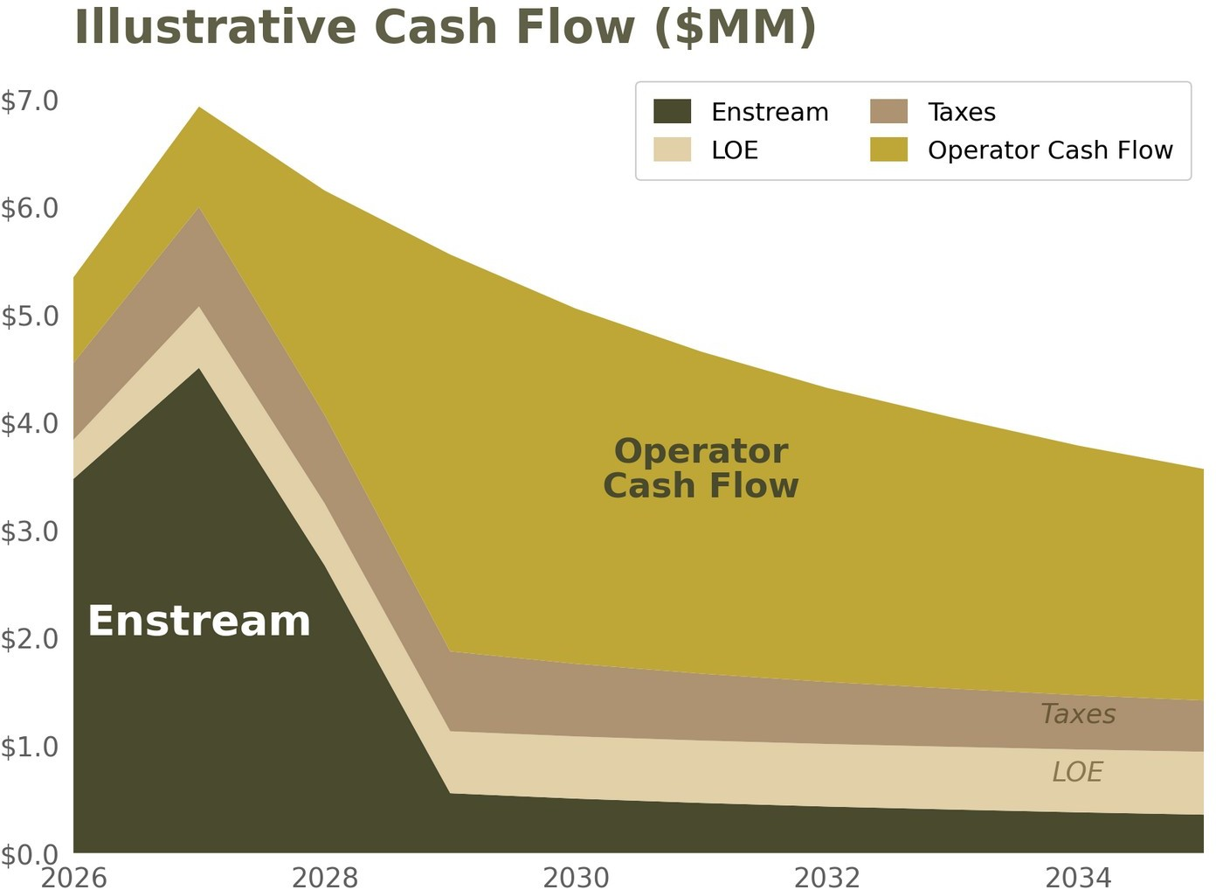
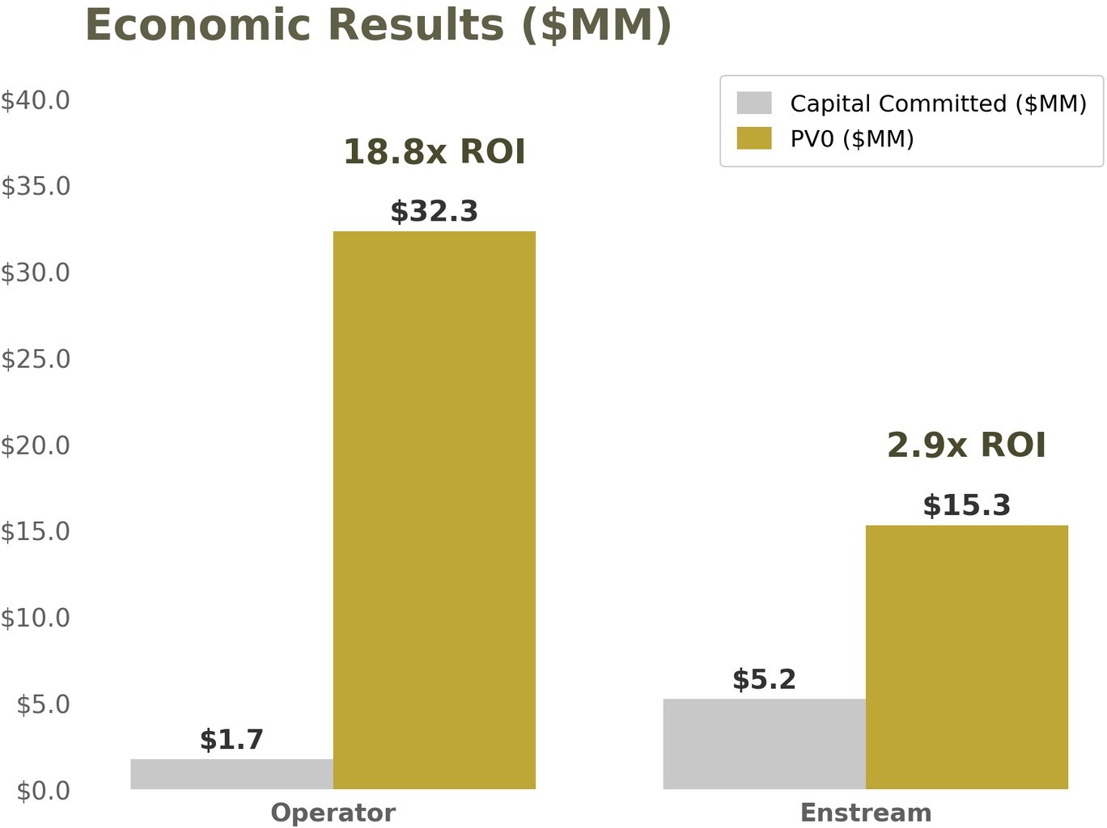
Economic Summary
@ $65/bbl WTI and $3.25/mmbtu HH NYMEX Pricing Flat

Slide 12
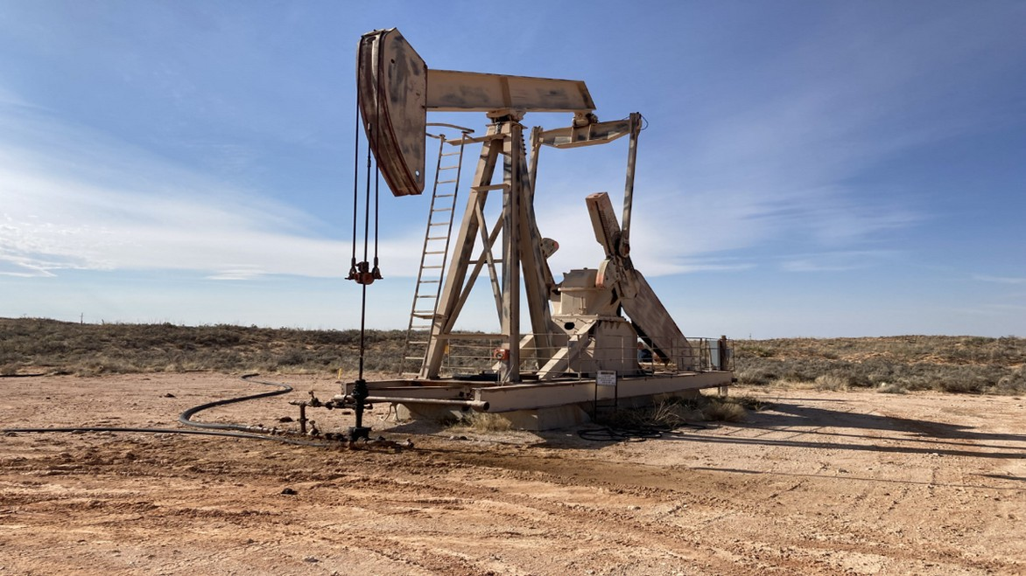
Northwest Shelf, New Mexico
$2.4MM – 25-well PDNP activation and workover plan
Key metrics
$2.4MM
ORRI purchase price (100% of Capex)
ORRI structure
25-45% of NRI
Before Payout
100 BOEPD
Operator contributes PDP, receives “Free Carry”
1-10% of NRI
Aker Payout
200%+
Payout target
ORRI Reconveyance Option
2 – 4 Years

Slide 13
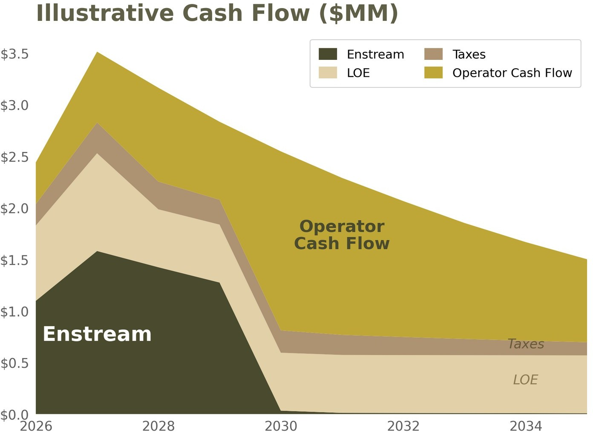
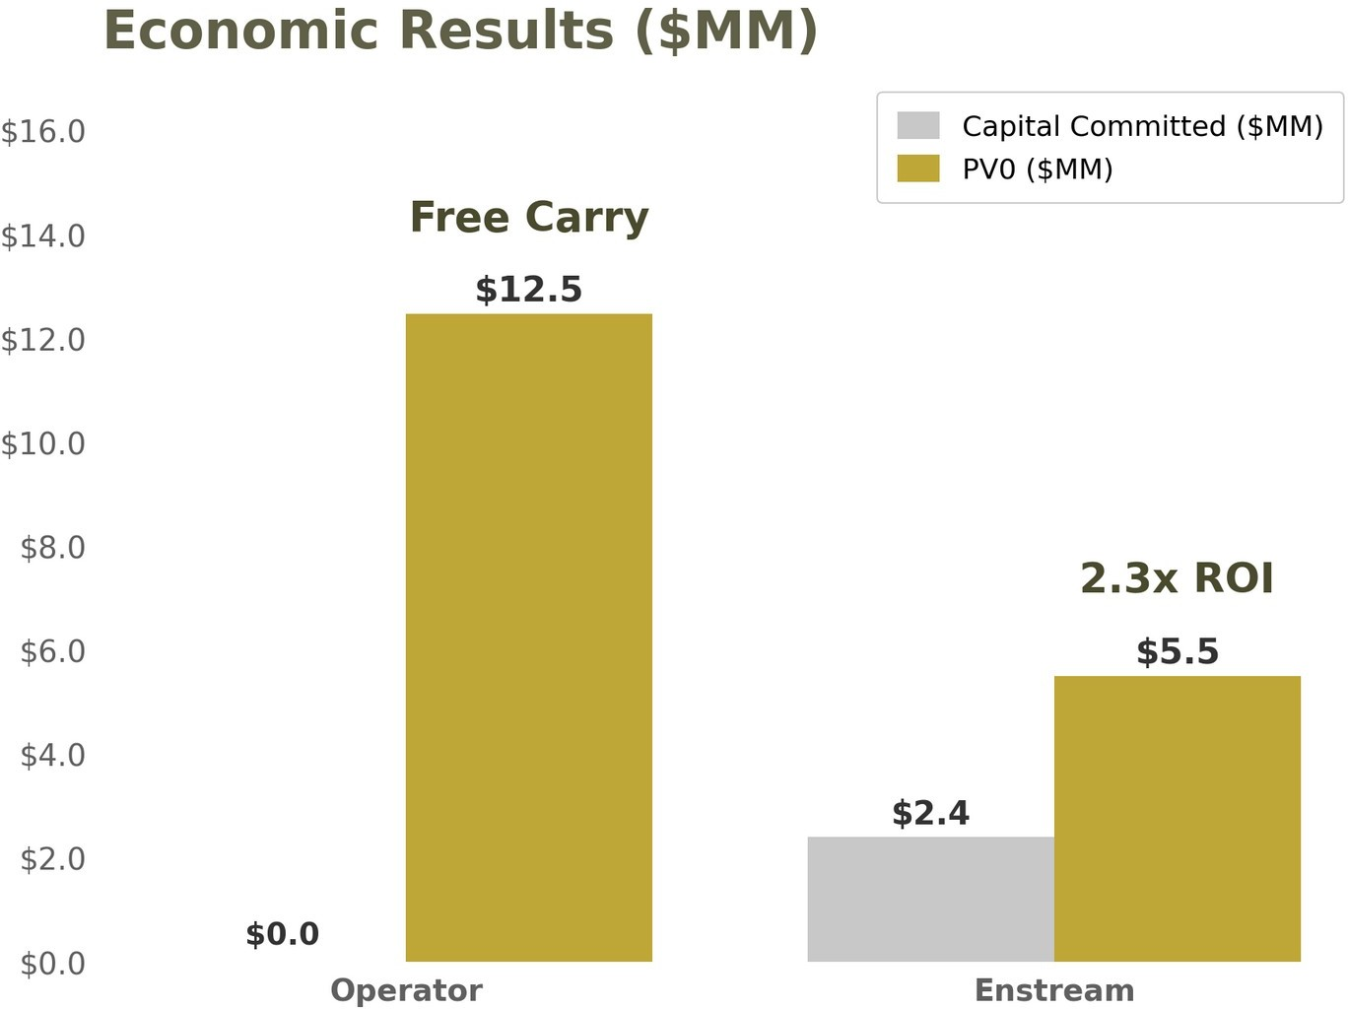
Economic Summary
@ $65/bbl WTI and $3.25/mmbtu HH NYMEX Pricing Flat

Slide 14

Ideal Candidate Attributes
PDNP proved reserves
$3–$30MM transactions
Mature infrastructure
With offset production and engineering support
Sized for efficient diligence and repeatable deployment
Existing facilities, gathering, takeaway, roads
200%+ project level payout
Clear development plan
Aligned operator
Production economics support target returns
Defined scope, schedule, budget; near-term first production
Co-invests and retains reconveyance option, keeping incentives aligned
If you know an operator with proved reserves waiting on capital, we'd welcome the introduction.

Slide 15
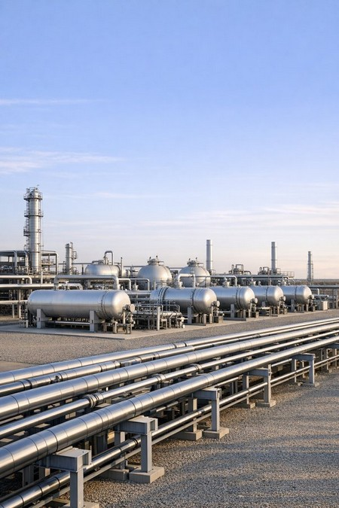
Con>dential Materials
Definitive Documentation Required
This presentation does not constitute an offer to sell or a solicitation to purchase any interest, under the Securities Act of 1933, the Securities Exchange Act of 1934, the Investment Advisers Act of 1940, the Texas Securities Act, or any other applicable law. The transactions described are arm's-length purchases and sales of overriding royalty interests — real property interests — and are not securities offerings, investment contracts, or lending arrangements.
Prospective sellers and counterparties should review all documentation with financial, legal, and tax advisors before entering into any transaction. Enstream provides no advice and makes no representations regarding tax or accounting treatment.
This document is strictly confidential, prepared solely for the recipient's use, and may not be reproduced or distributed, in whole or in part, without Enstream's prior written consent.
Projections and forward-looking statements are illustrative, based on assumptions, and inherently unpredictable.
Transactions are consummated only pursuant to definitive documentation (the “Documentation”), which controls in the event of any conflict with this presentation.
Confidential and Proprietary Information of Enstream Capital Management, LLC

Slide 16
Questions?
Dan Mooney | 214.468.0900 | dmooney@ecmtx.com
Confidential and Proprietary Information of Enstream Capital Management, LLC
16

Slide 17
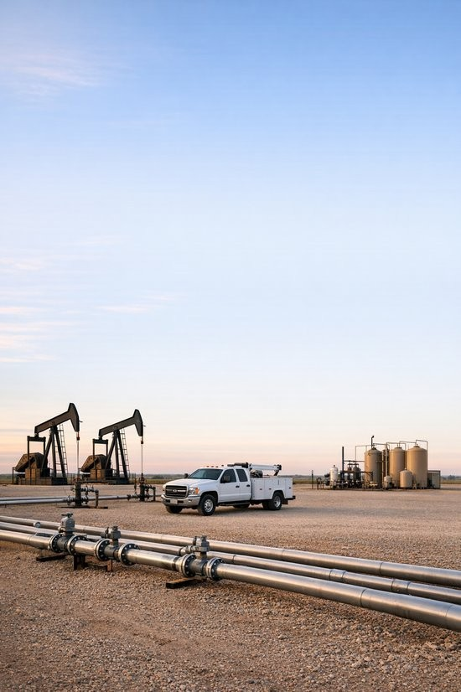




Send Us Your Reserve Report
We'll tell you in two weeks if we can close.
Start with a reserve report and development plan. You keep the wells. You keep the company.
Dan Mooney
214.468.0900
dmooney@ecmtx.com
100 Crescent Court Suite 700, Dallas TX 75201
Business Card
LinkedIn
Website
17

