Slide 1
Dr. Alexandria Watkins DNP-APRN, FNP-C
Spreading Hope, not covid

Slide 2
“Titles are but nicknames, and every nickname is a title.” -Thomas Paine
SARS-CoV-2 is the name of the VIRUS that causes the DISEASE, COVID-19
COVID-19 Definition:
CO-Corona, VI-Virus, D-Disease, 19-Year of Outbreak

Slide 3
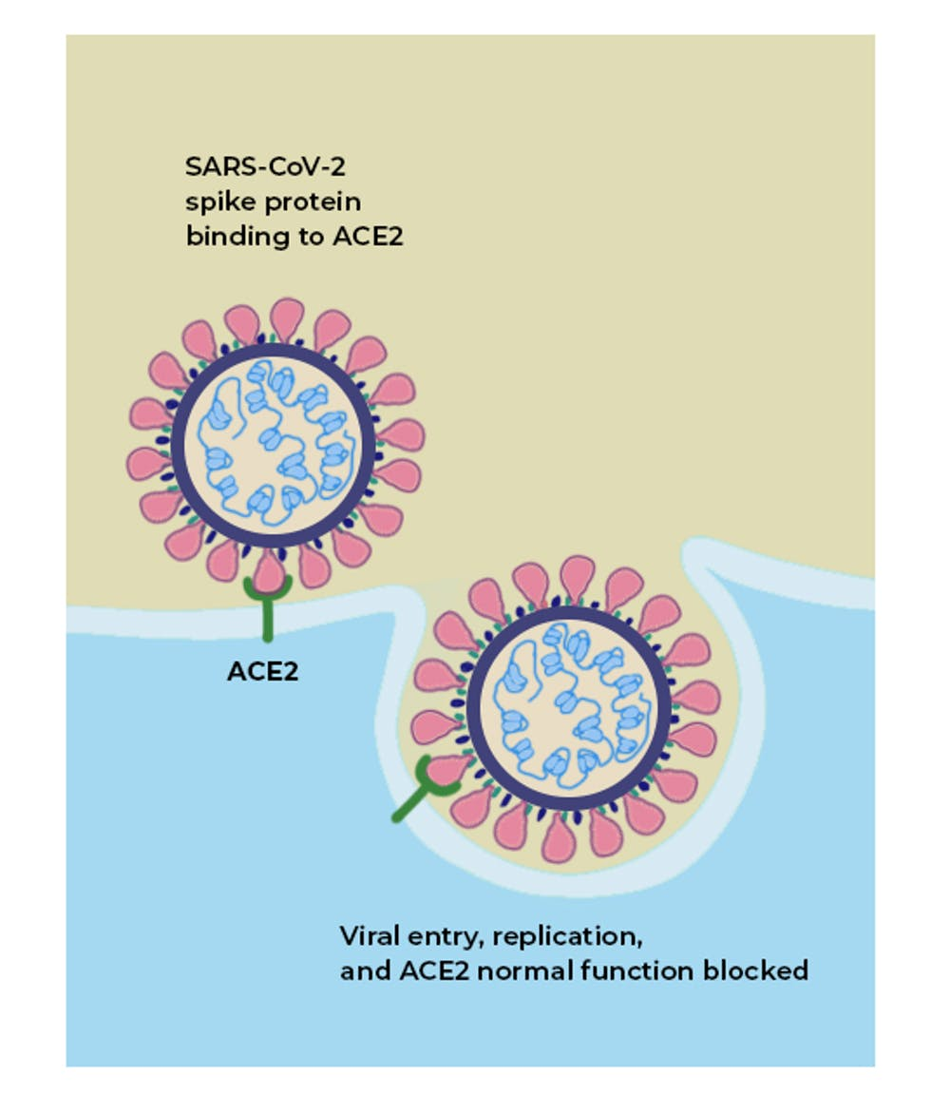
What is ACE 2 & Why is it Important?

Slide 4
Angiotensin-Converting Enzyme 2 (ACE2)
Entry Point for SARS-CoV-2
Where is ACE2 Found
ACE2 & Inflammation
NOSE
MOUTH
LUNGS
HEART
BLOOD VESSELS
KIDNEYS
LIVER
GASTROINTESTINAL TRACT
ACE2 acts as a CELLULAR DOORWAY.
ACE2 is a PROTEIN on the surface of many cells.
ACE2 REGULATES cell functions.
Inflammation caused by COVID-19 creates Death of Cells in the Alveoli.
Alveoli are critical for bringing Oxygen into the body.
Alveoli is where Carbon Dioxide is released.

Slide 5
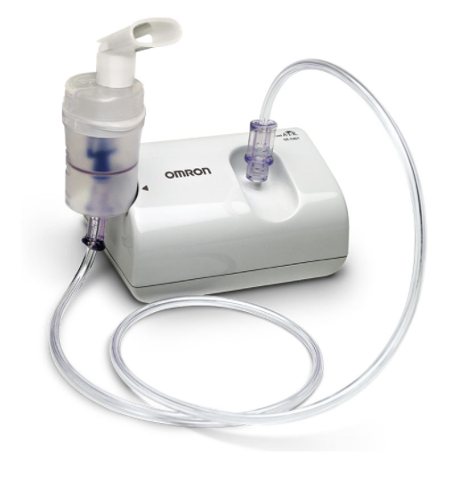
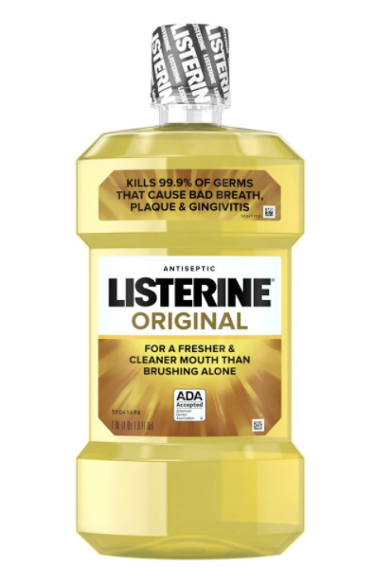
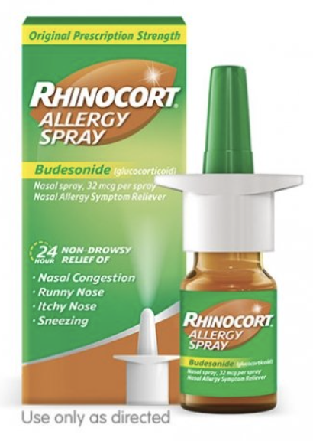
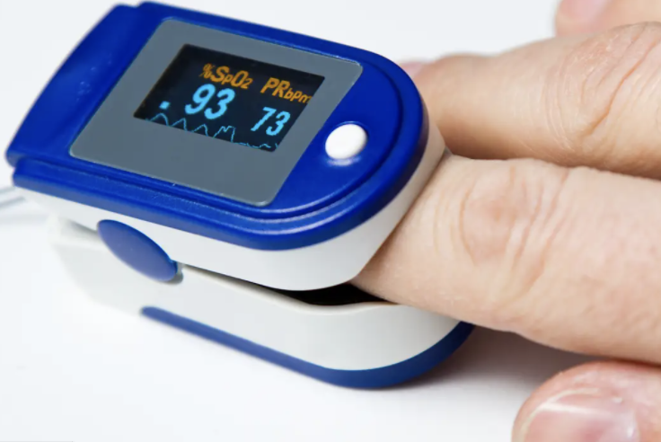
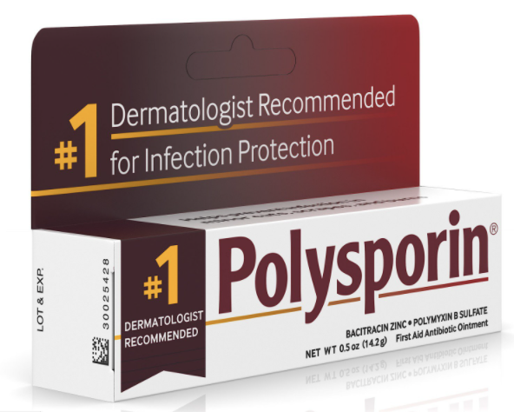
How Can I Be Prepared for COVID-19?
PURCHASE:
Nebulizer Machine ($30-$60 online)
Pulse Oximeter
Thermometer
Zinc 50mg & Baby Aspirin 81mg
Rhinocort (budesonide) Nasal Spray
Polysporin
Listerine Mouthwash

Slide 6
How Can I Boost My Immune System?
Vitamin A 10,000 IU WEEKLY
Vitamin C 1,000mg 4 TIMES DAILY
Vitamin D 10,000 IU DAILY
Quercetin 500mg DAILY
N-Acetyl Cysteine (NAC) 900mg DAILY
Liposomal Glutathione 400-500mg 1-2 TIMES DAILY
Curcuplex-95 or Meriva-SF 1000-1500mg 3 TIMES DAILY
HAND HYGIENE
1. Wet
2. Lather
3. Scrub (20 seconds)
4. Rinse
5. Dry

Slide 7
“Help, I have COVID-19!”

Slide 8
COVID-19 Symptoms
Fever (100.4 or Higher) or Chills
Muscle or Body Aches
Cough
Sore throat
Sinus Pressure with NO Drainage
Diarrhea
Shortness of breath
Difficulty breathing
Fatigue
Headache
New loss of taste or smell
Nausea or Vomiting

Slide 9
10-Day COVID-19 Protocol
Budesonide 0.5mg Nebulized Once in the Morning & Once in the Evening
Budesonide can be SAFELY Nebulized every 2-Hours if needed for
Shortness of Breath, Chest Tightness or Chest Congestion
Antibiotic - Coverage for Atypical Bacteria
Ex. Biaxin (clarithromycin) 500mg Tab Twice Daily for 7-Days
Ivermectin (weight-based dosing)
Zinc 50mg Daily
Baby Aspirin 81mg Daily (for adults)

Slide 10
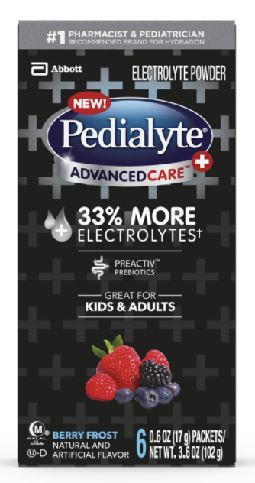
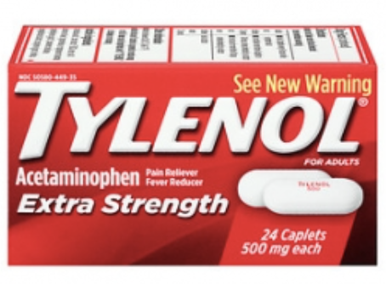
COVID-19 Symptom Management
TYLENOL 1000mg every 4-Hours
(9:00am, 1:00pm, 5:00pm, 9:00pm)
OR
TYLENOL 2000mg every 12-Hours
(9:00am and 9:00pm)
***DO NOT EXCEED 4000mg OF TYLENOL IN A 24-HOUR PEROID.
DRINK 0.5oz for EVERY 1 pound of weight.
Drink at least 30oz of Electrolytes per Day.

Slide 11
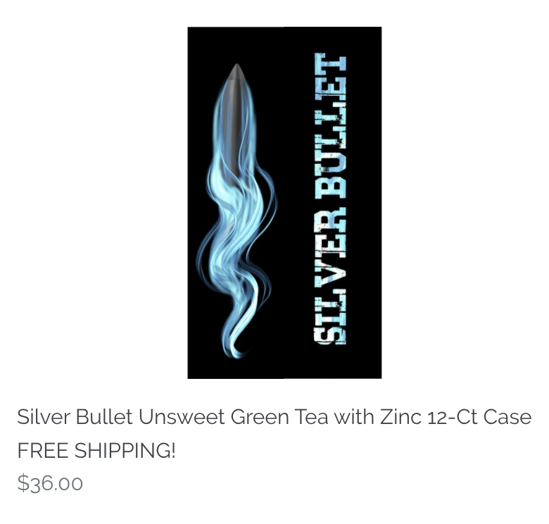
h2bev.com

Slide 12
FAQ
Should I get the COVID-19 Vaccine?
Are mask necessary?
How long do I have to be on this protocol?
What’s a “False Negative”?
Can diabetics take budesonide?
How long do COVID-19 antibodies last?
What are the long-term effects of COVID-19?

Slide 13
Questions?
Alexandria Watkins, DNP-APRN, FNP-C
Phone: 432-268-3773
Email: anw@liveinfusions.com
*Website: www.budesonideworks.com
Website: www.liveinfusions.com

